Slide 1


ChampionsMonstersDragons
By Jacob Brown

Slide 2
Summary
This app is meant as a companion app to a card game (no name as of yet) that I am developing in my spare time.
It will allow you to create an account and view and track your stats, friends, cards, decks. You will also be able to recommend cards to friends, share deck builds you have made and compare stats. You will also be able to get more cards from the store.
As an admin user it will allow the ability to add, delete or edit cards. You can access the registered users to make changes.

Slide 3
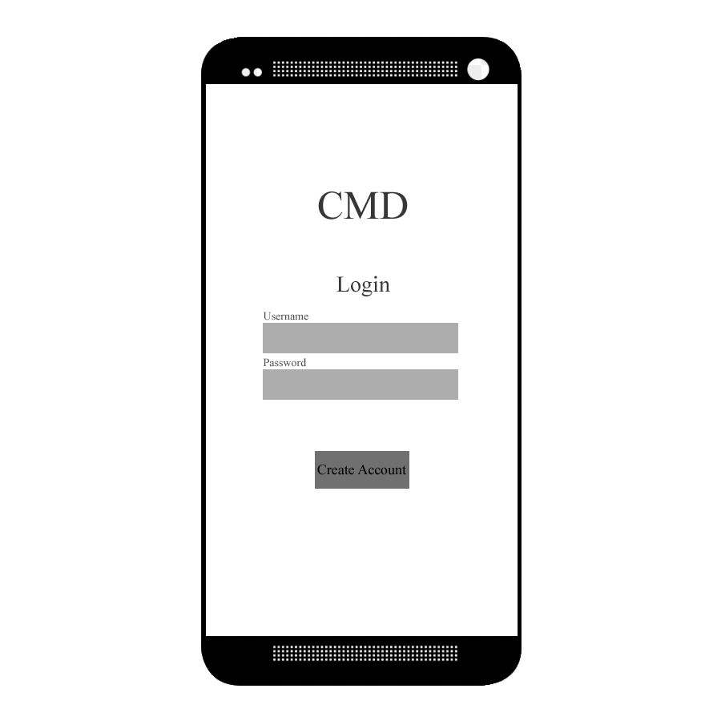
<As a> User, <I want to> open the app <so that> I can see the login page.

Slide 4
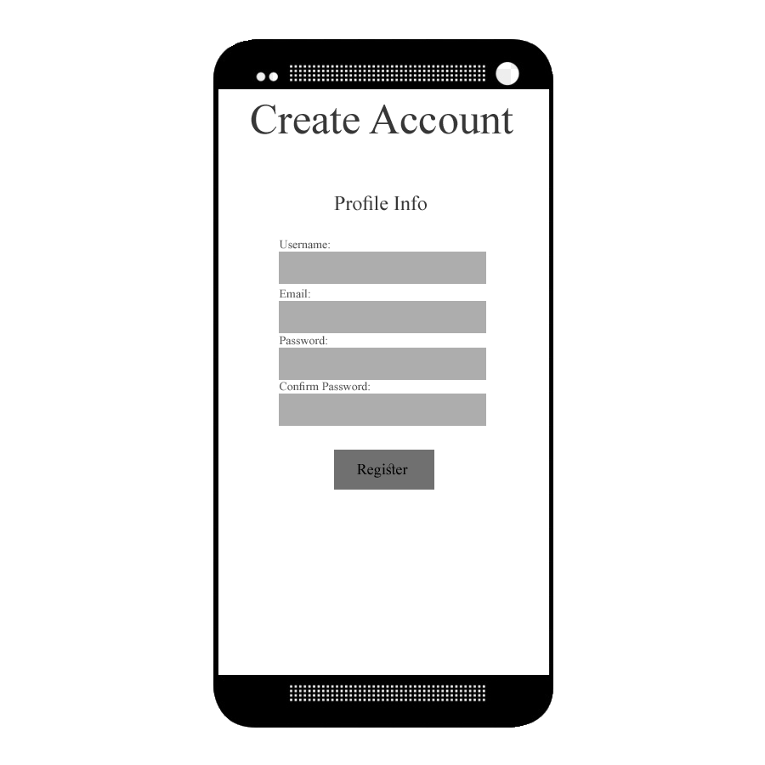
<As a> User, <I want to> create an account <so that> I can access the app.

Slide 5
<As a> User, <I want to> log in to my account <so that> I can view my home screen.

Slide 6
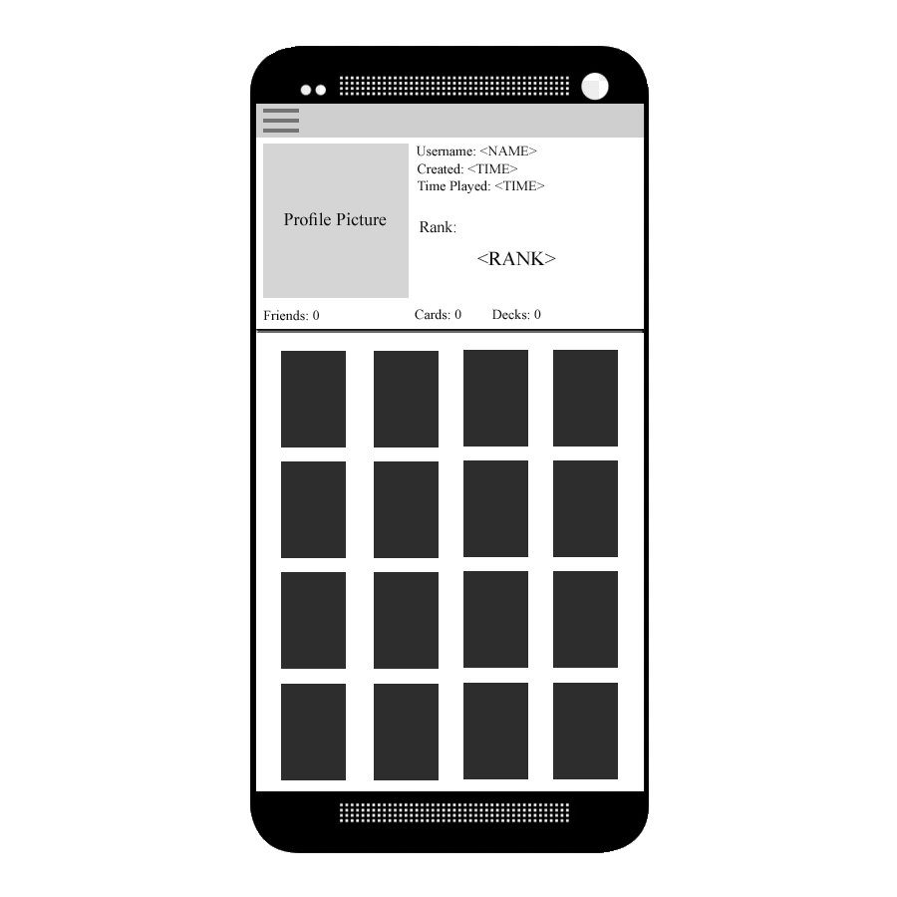
<As a> User, <I want to> see my homescreen display my account stats <so that> I can track account progress.

Slide 7
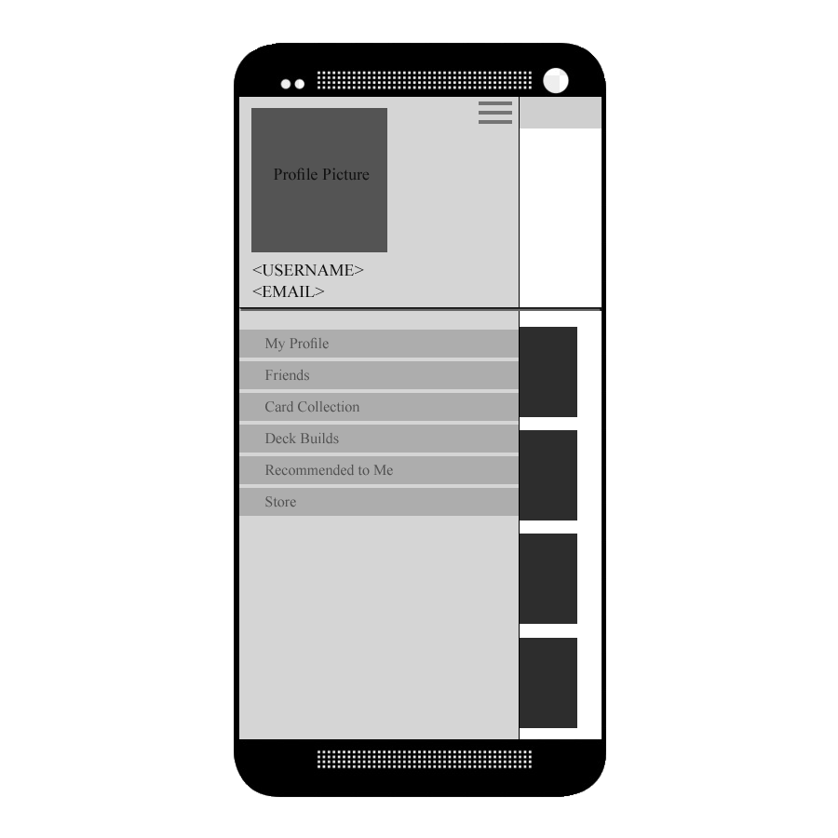
<As a> User, <I want to> open a drawer on the home screen <so that> I can view my profile, friends, card collection, decks, cards recommended to me, or the store.

Slide 8
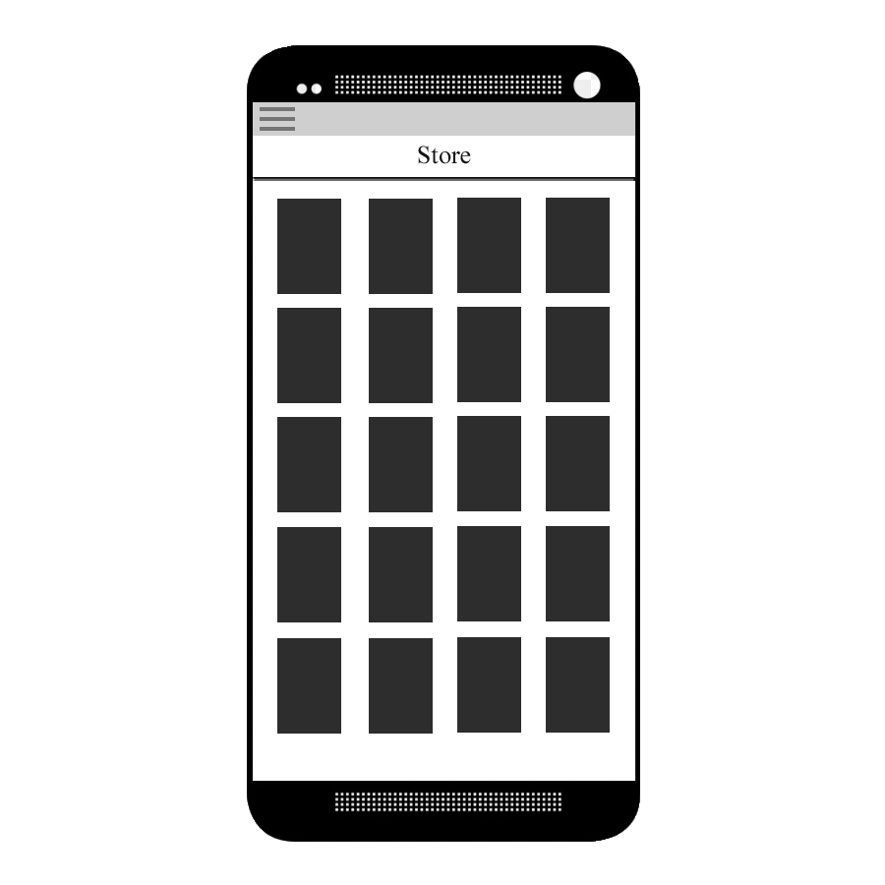
<As a> User, <I want to> open the store to get additional cards <so that> I can add them to my collection.

Slide 9
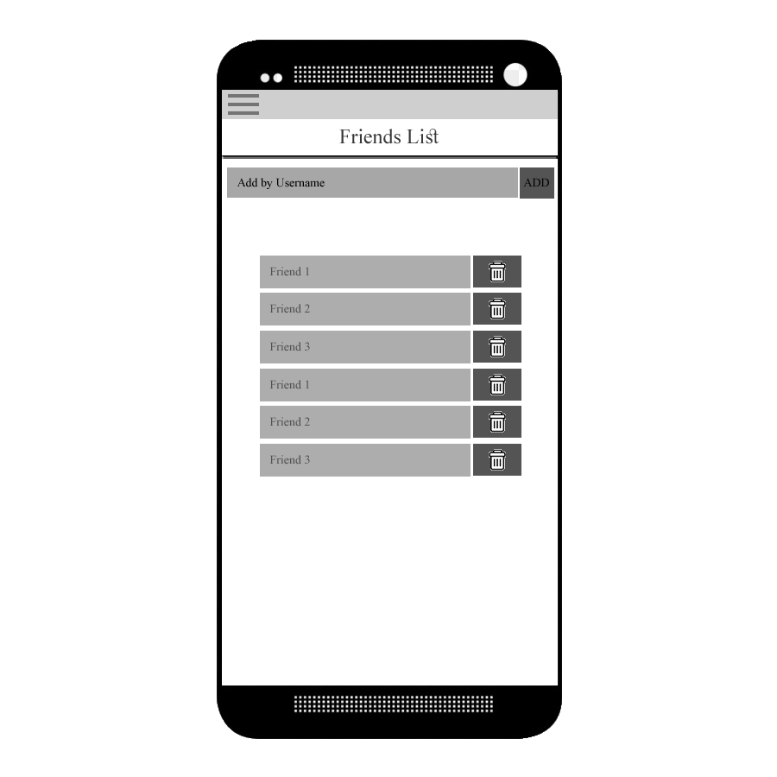
<As a> User, <I want to> view my friends list <so that> I can see my friends and add or delete them.

Slide 10
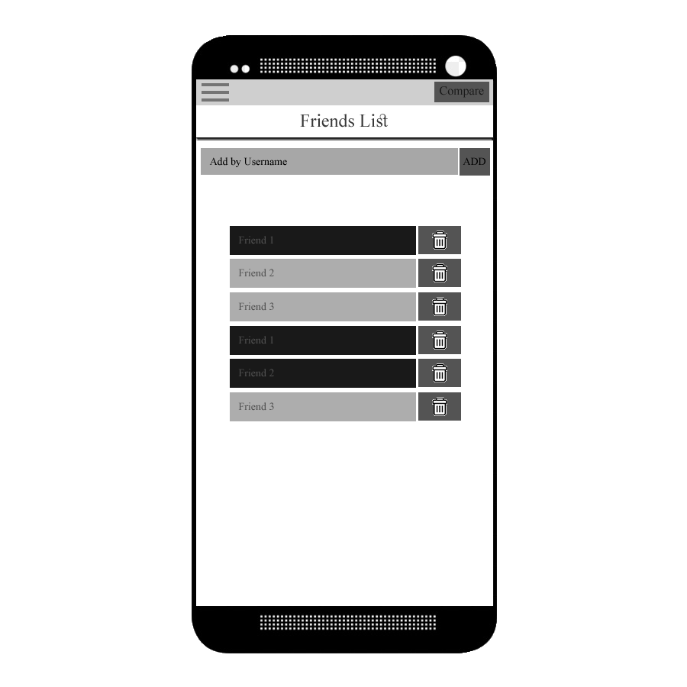
<As a> User, <I want to> select friends in my friends list and compare stats <so that> I can gloat about my wins.

Slide 11
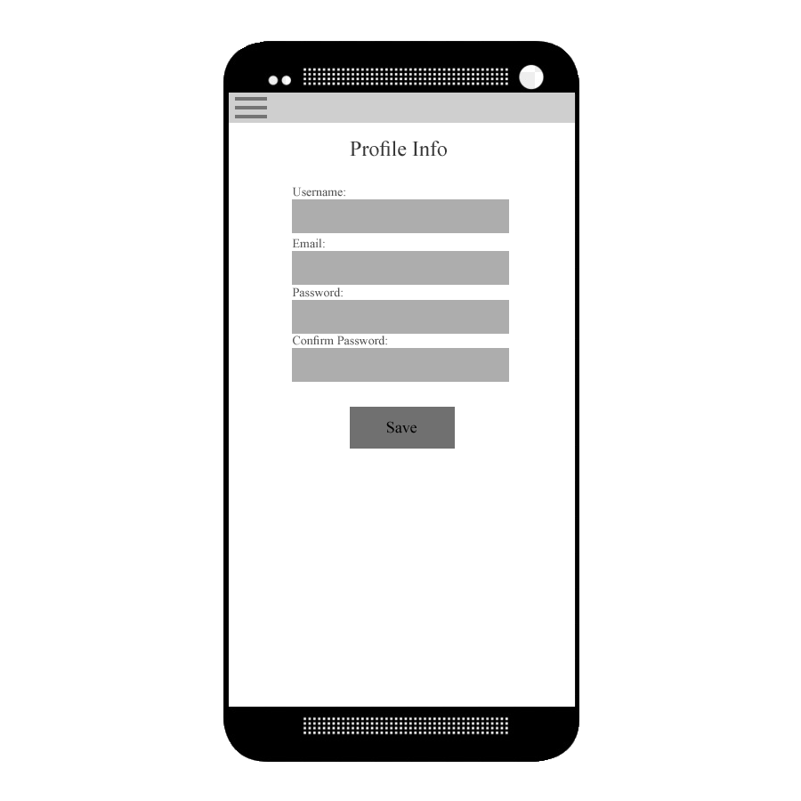
<As a> User, <I want to> view my profile <so that> I can make changes to it.

Slide 12
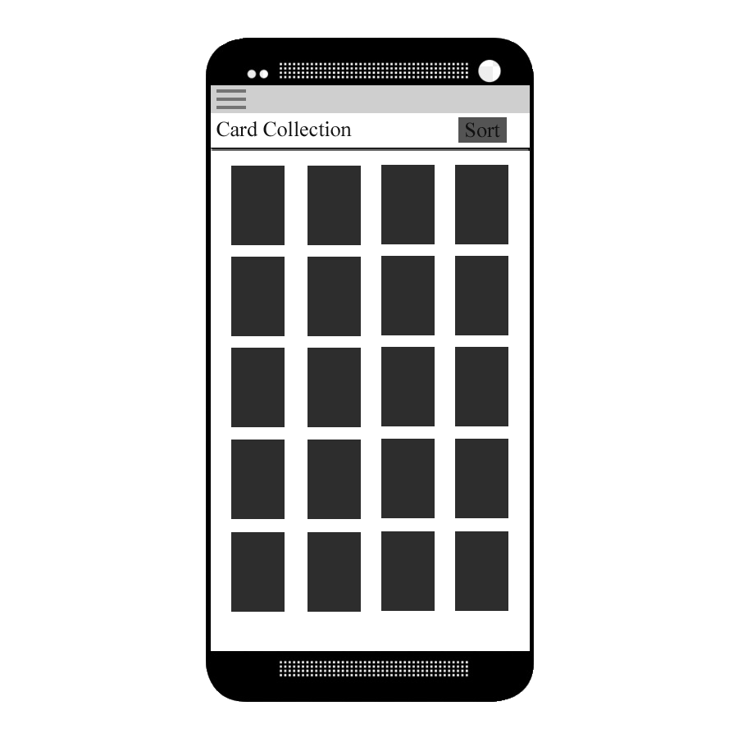
<As a> User, <I want to> view my card collection <so that> I may sort my cards and browse through them.

Slide 13
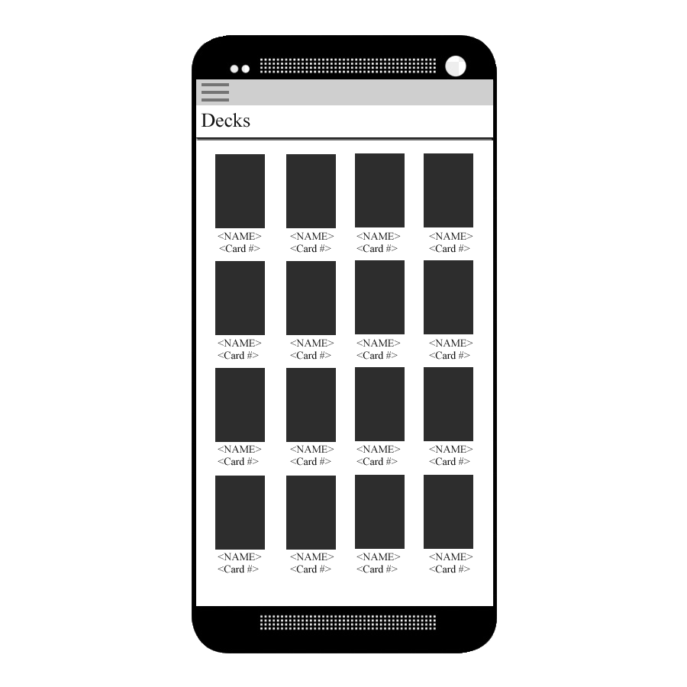
<As a> User, <I want to> view my decks <so that> I may add, delete or edit them.

Slide 14
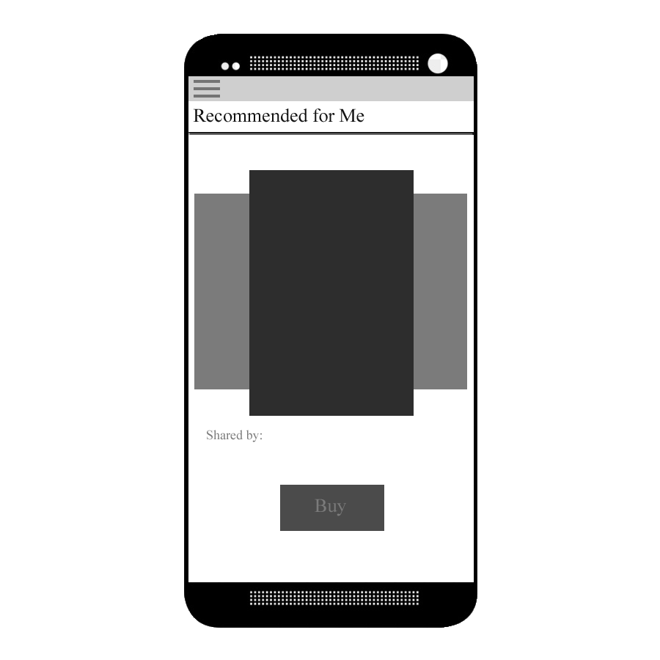
<As a> User, <I want to> view cards recommended to me <so that> I can see what my friends suggest I use.

Slide 15
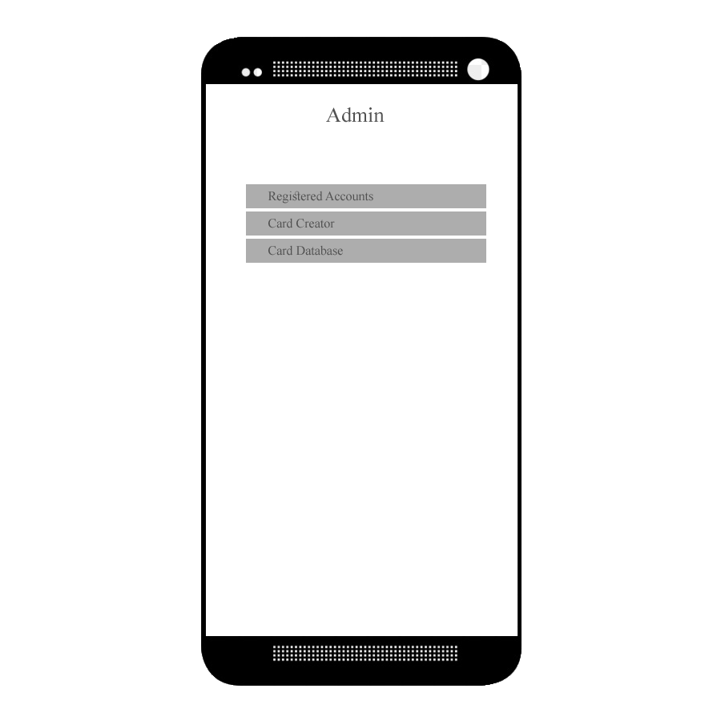
<As a> Admin, <I want to> log in to my account <so that> I may access my admin abilities.

Slide 16
<As a> Admin, <I want to> see the homescreen display what actions I may take <so that> I can navigate my options immediately.

Slide 17
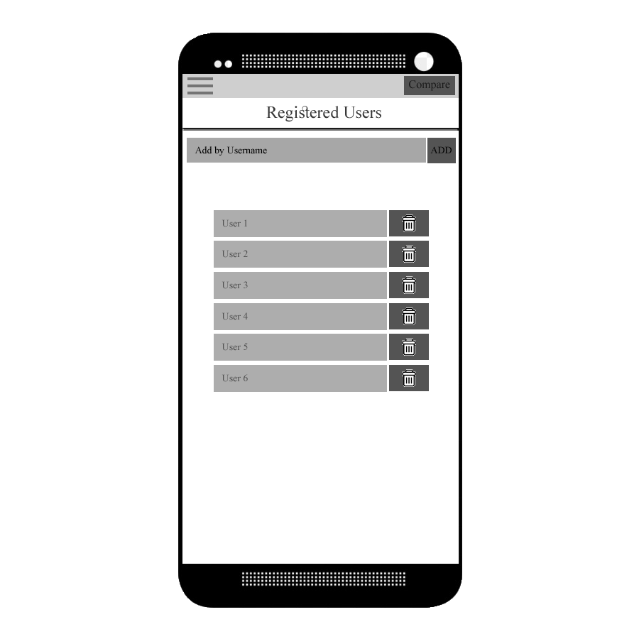
<As a> Admin, <I want to> view a list of registered accounts <so that> I may add, delete or edit them.

Slide 18
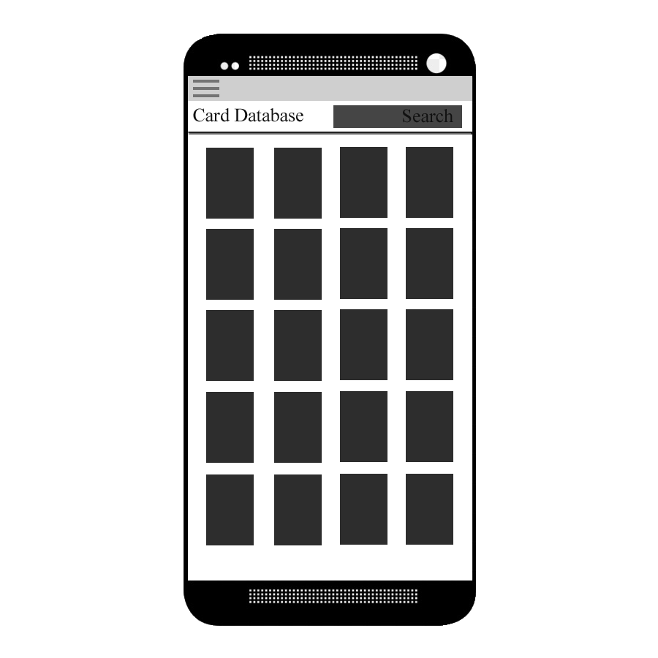
<As a> Admin, <I want to> view cards in the database <so that> I can make changes.

Slide 19
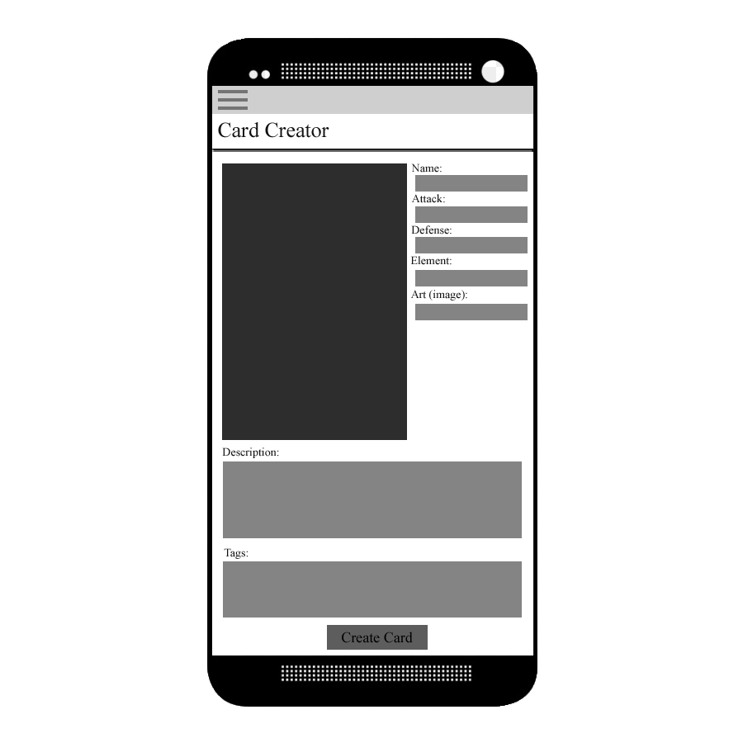
<As a> Admin, <I want to> create and add cards to the database <so that> I can document card ideas on the go.

